Slide 1

TITANIC: KAGGLE CHALLENGE
ADVANCED AI FOR DATA SCIENCE I
TEAM 7
1

Slide 2
EXPLORATORY DATA ANALYSIS
1

Slide 3
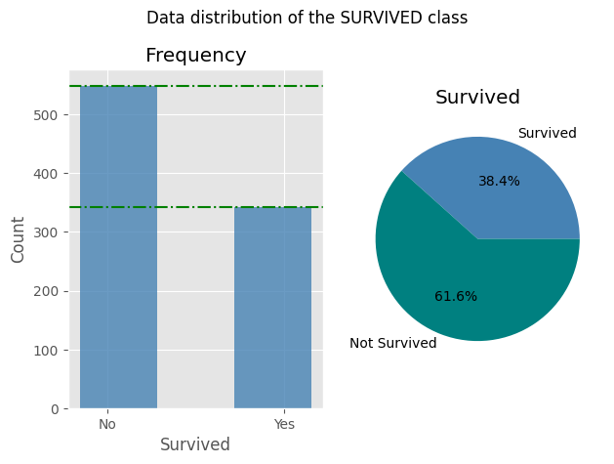
TARGET DATA DISTRIBUTION

Slide 4
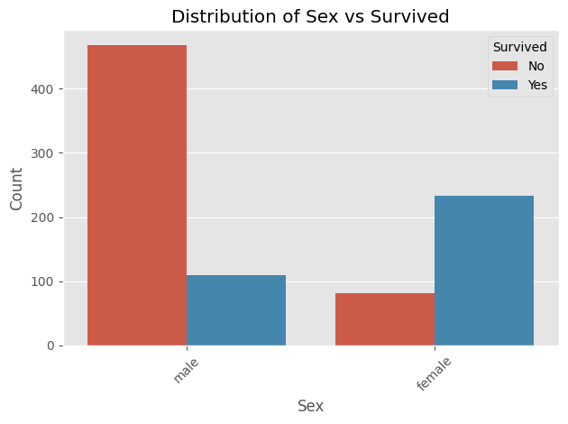
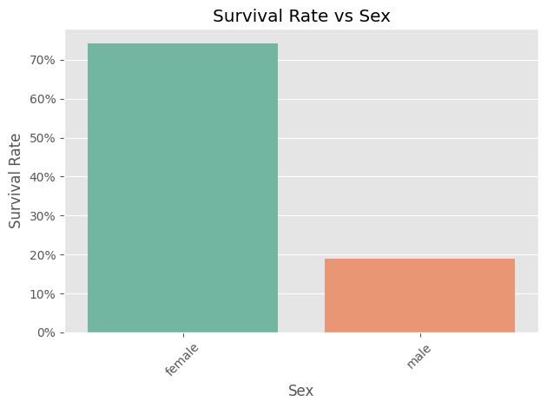
CATEGORICAL DATA DISTRIBUTION

Slide 5
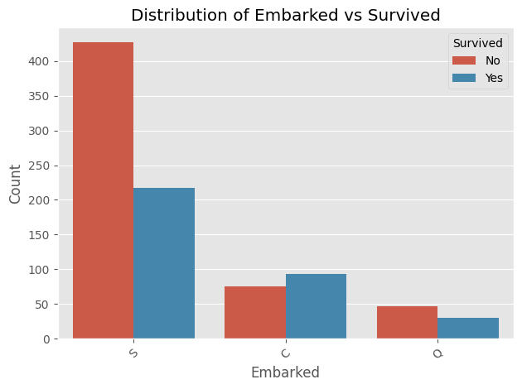
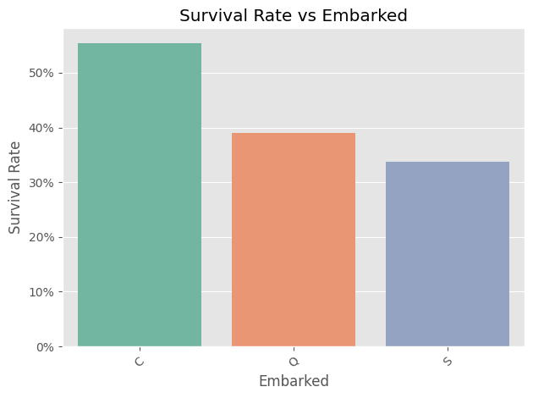
CATEGORICAL DATA DISTRIBUTION

Slide 6
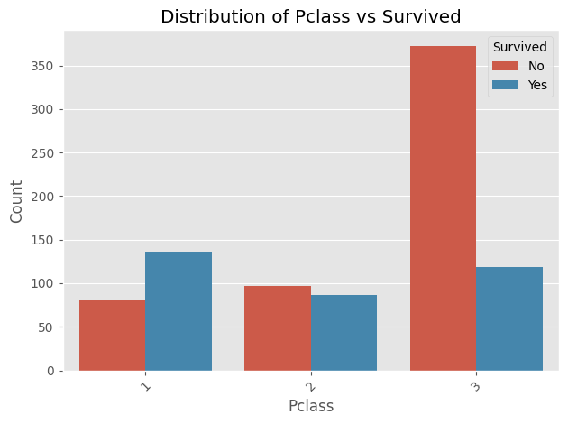
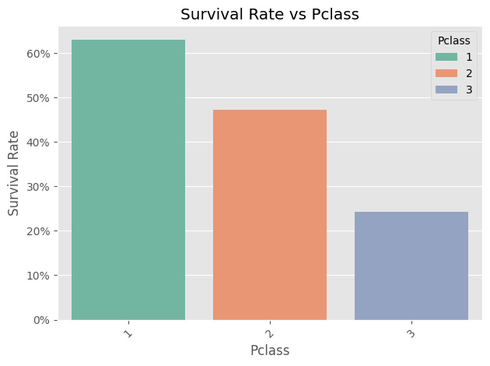
CATEGORICAL DATA DISTRIBUTION

Slide 7
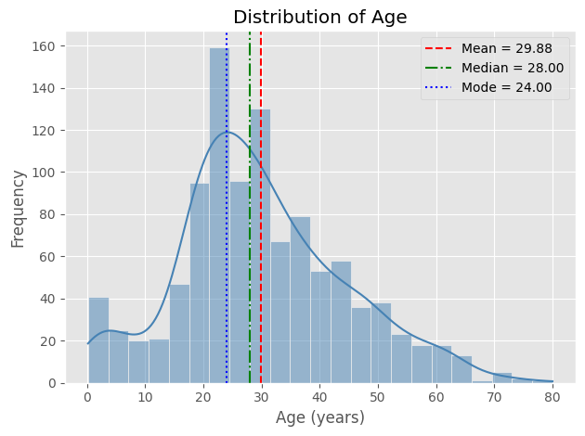
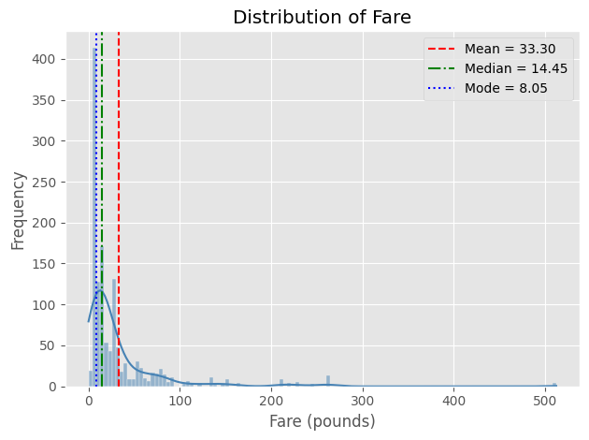
NUMERICAL DATA DISTRIBUTION

Slide 8
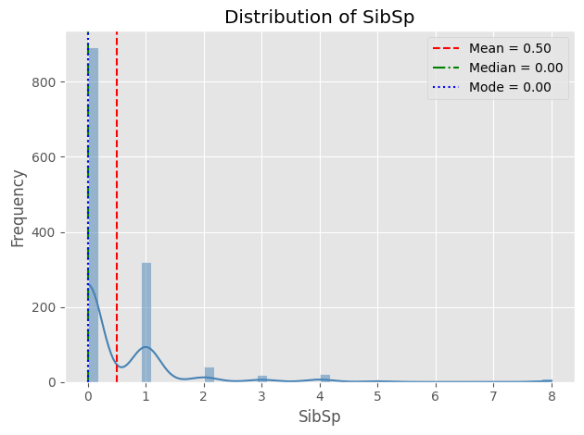
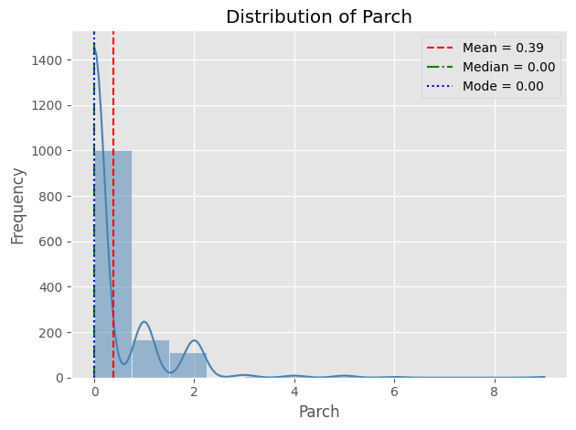
NUMERICAL DATA DISTRIBUTION

Slide 9
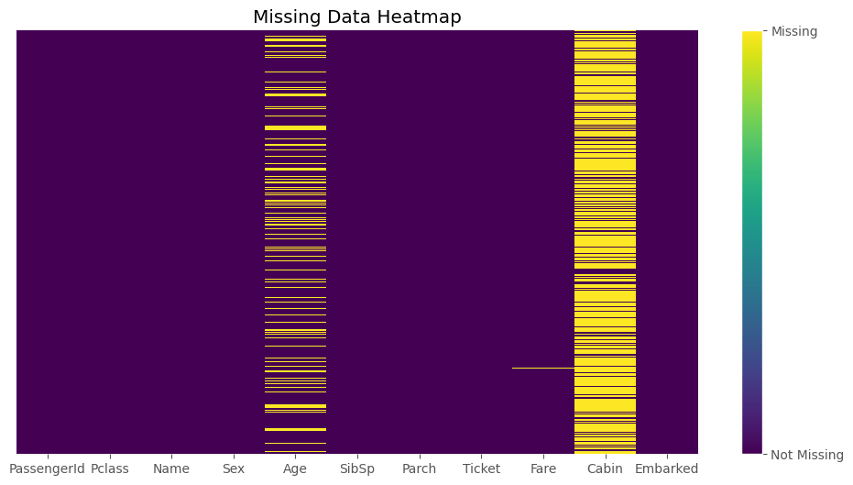
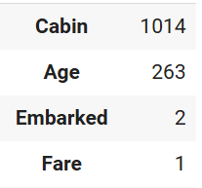
MISSING DATA
Median:
Age
Fare
Mode:
Embarked
Remove:
Cabin

Slide 10
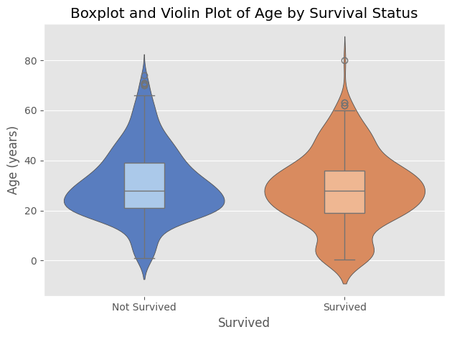
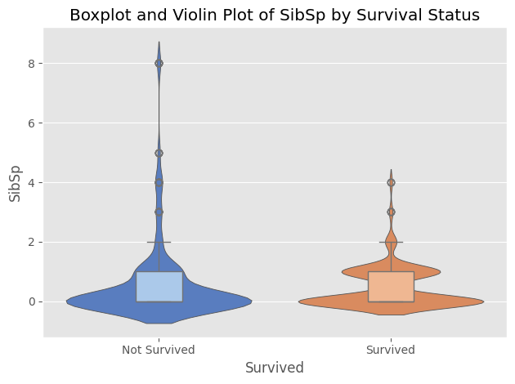
BOXPLOTS / VIOLIN PLOTS

Slide 11
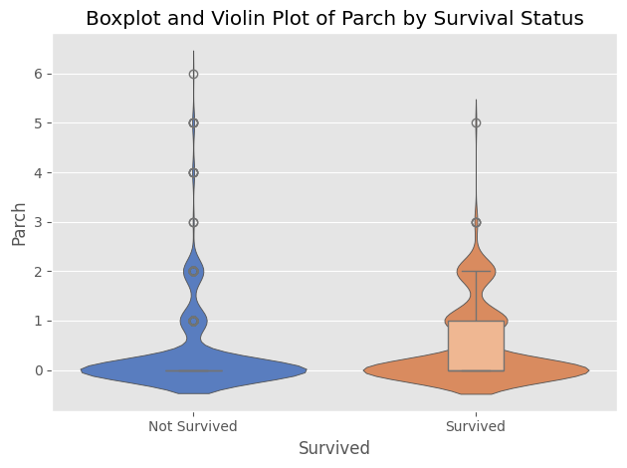
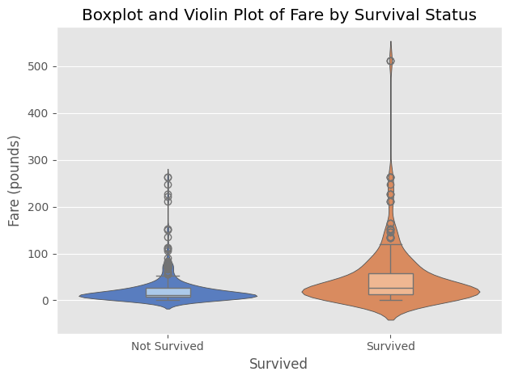
BOXPLOTS / VIOLIN PLOTS

Slide 12
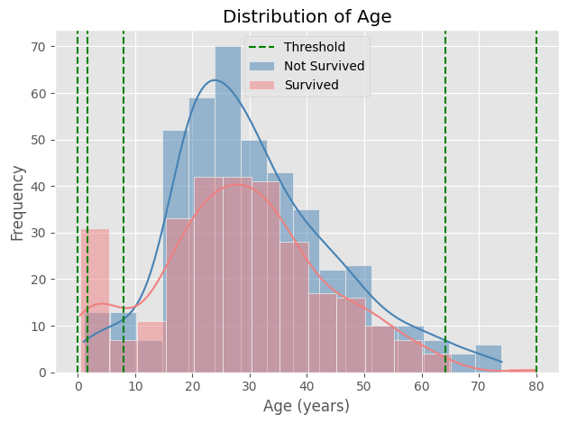
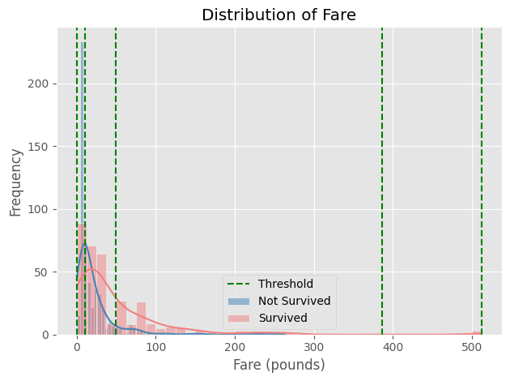
DISCRETIZATION

Slide 13
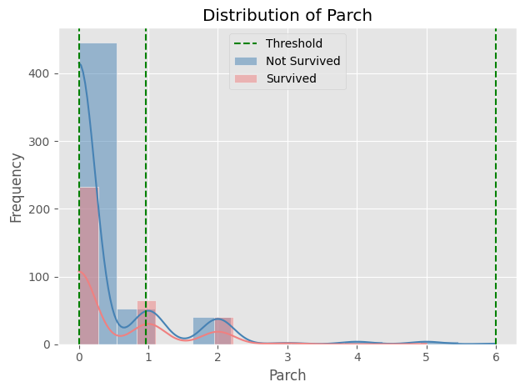
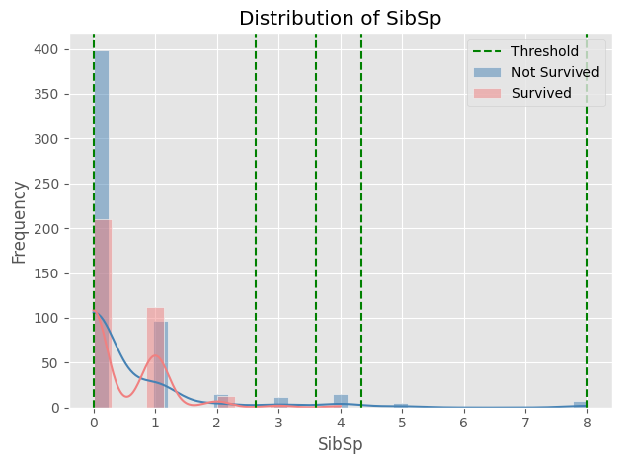
DISCRETIZATION

Slide 14
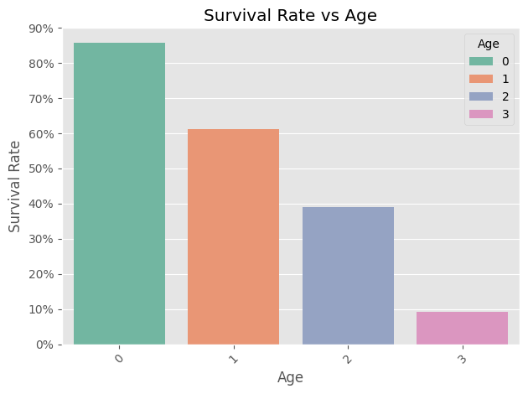
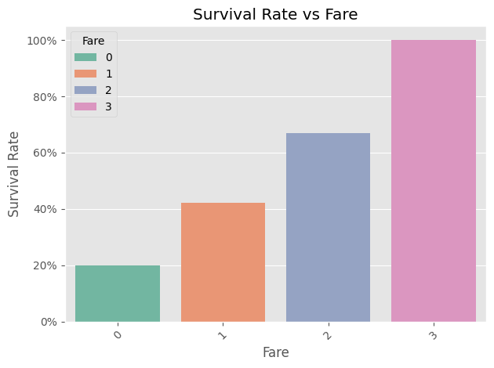
DISCRETIZATION RESULTS

Slide 15
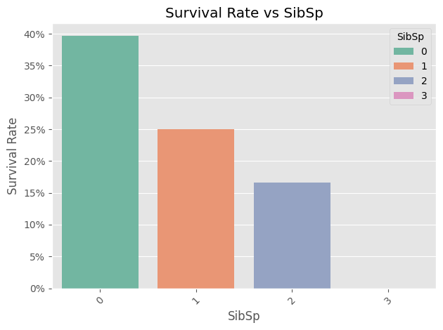
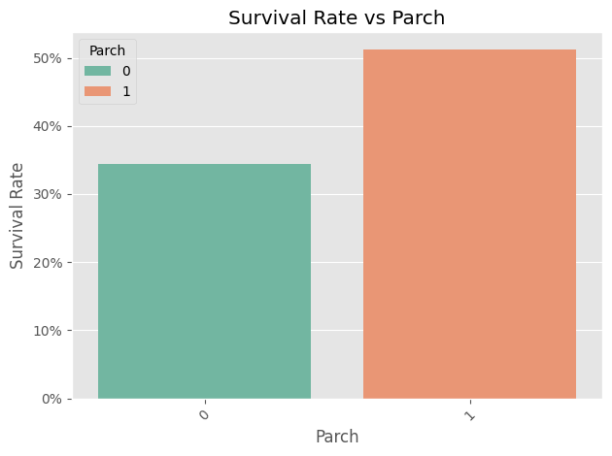
DISCRETIZATION RESULTS

Slide 16
FEATURE MANIPULATION
1

Slide 17
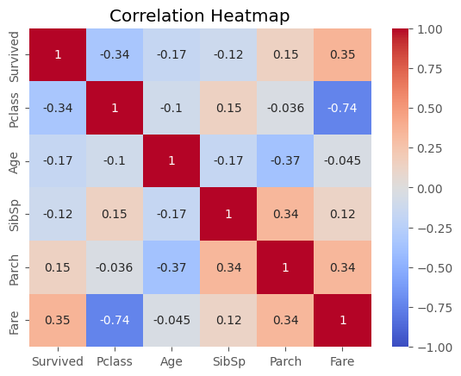
NUMERICAL CORRELATION MATRIX
Delete:
Parch
Pclass

Slide 18
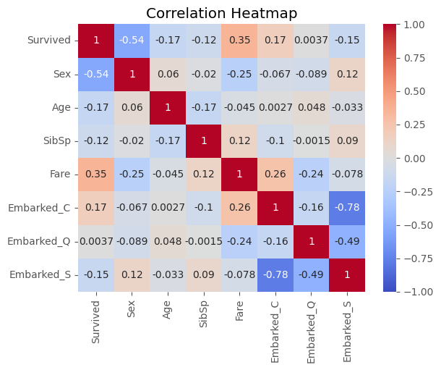
DATA ENCODING
Delete:
Ticket
Name
One-Hot:
Embarked
Label:
Sex
4. Delete:
Embarked_S
Embarked_Q

Slide 19
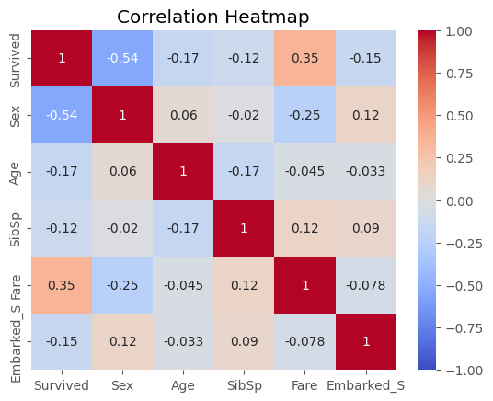
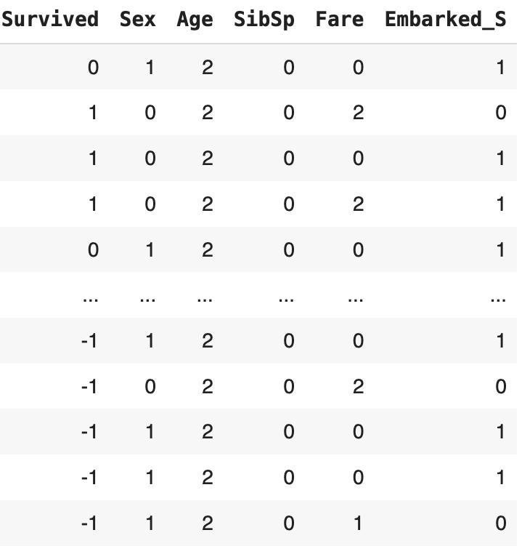
FINAL DATASET

Slide 20
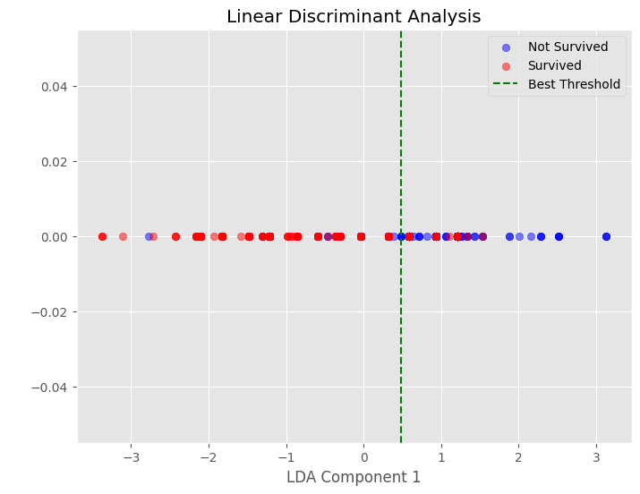
FINAL ANALYSIS
Mean F1 score: 0.7383
F1 score standard deviation: 0.032

Slide 21
MODEL SELECTION
1

Slide 22
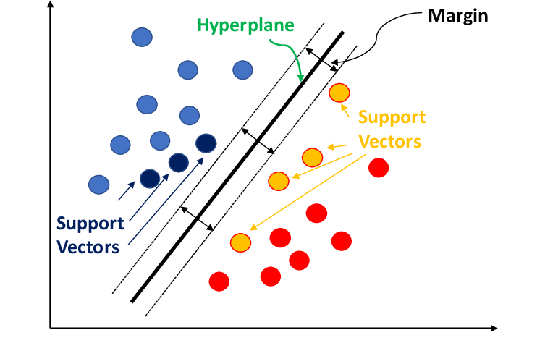
SUPPORT VECTOR MACHINE
Reasons:
linearly separable data
Effective with non collinear data
Works well with unbalanced classes
Technologies, D. (2022, 20 september). What is a Support Vector Machine? - Datatron. Datatron. https://datatron.com/what-is-a-support-vector-machine/

Slide 23
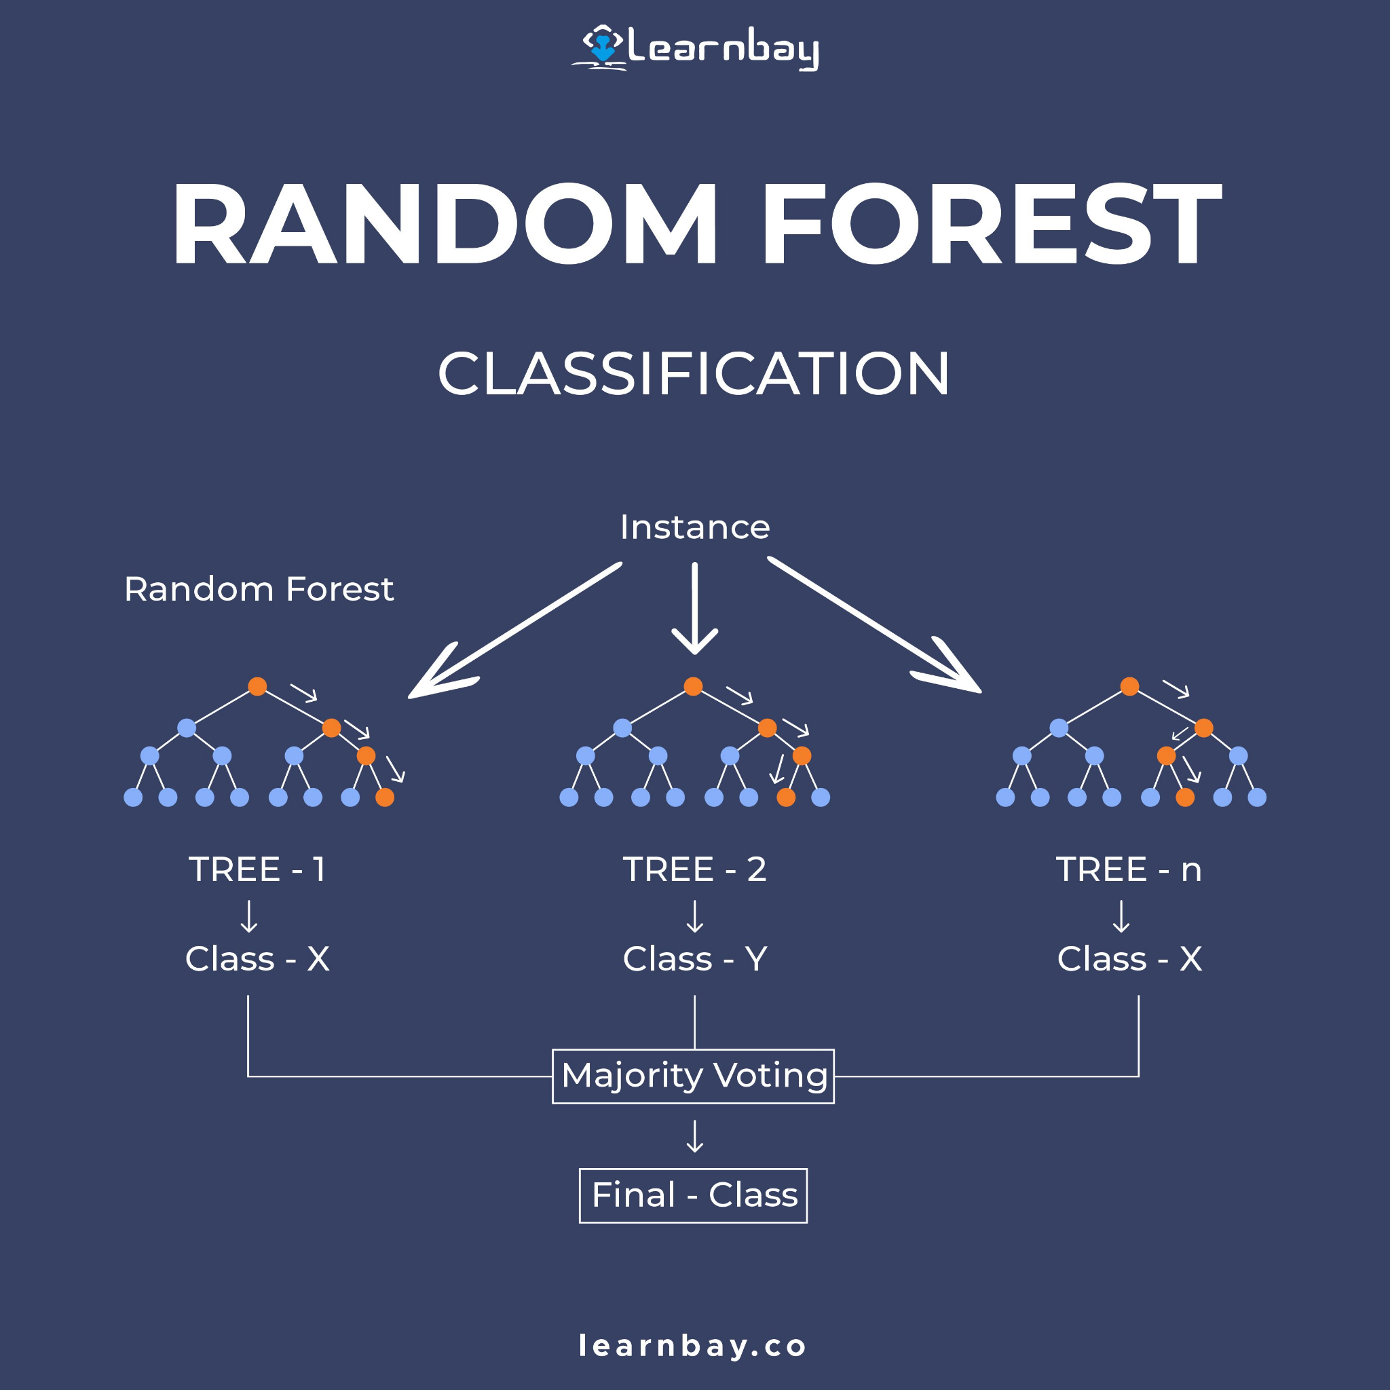
RANDOM FOREST
Reasons:
Non-linear relationships
Great for categorical and ordinal data
Feature Importance
Cotten, S. (2022, 28 august). Random Forest Classification. Pinterest. https://pt.pinterest.com/pin/848787861035795075/

Slide 24
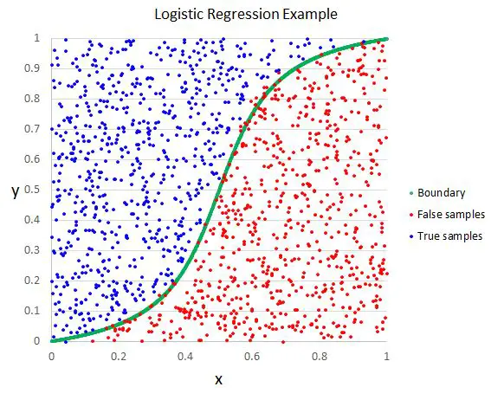
LOGISTIC REGRESSION
Reasons:
Simplicity and probabilistic Interpretability
Great for binary and discrete dataset
No multicollinearity issues
Chakure, A. (2023, 22 diciembre). What is logistic regression? Built In. https://builtin.com/data-science/what-is-logistic-regression

Slide 25
MODEL TESTING
1

Slide 26
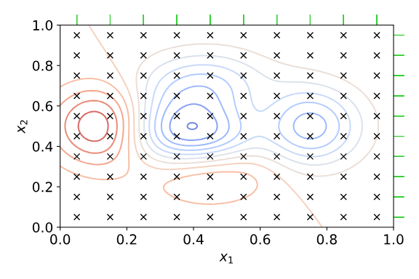
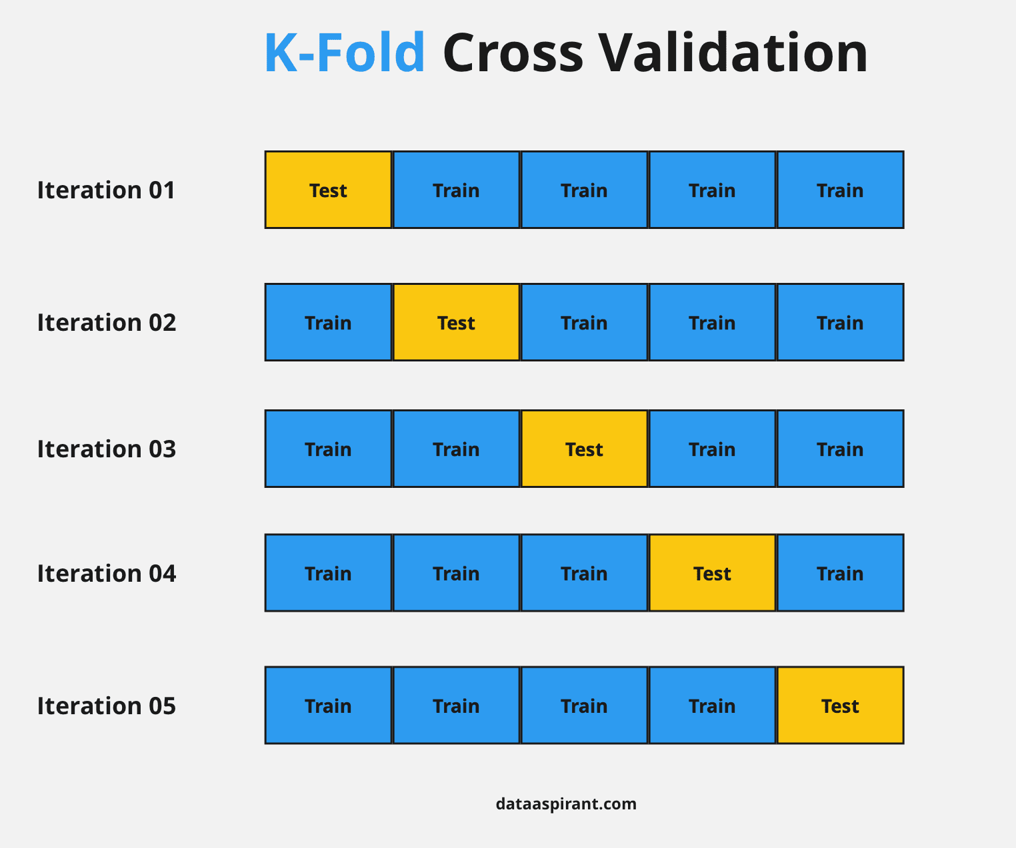
MODEL TESTING
Best parameters for SVM: {'C': 1, 'gamma': 'scale', 'kernel': 'rbf'}
Best parameters for Random Forest: {'criterion': 'entropy', 'max_depth': 10, 'min_samples_split': 10, 'n_estimators': 200}
Best parameters for Logistic Regression: {'C': 1, 'penalty': 'l2', 'solver': 'saga'}
colaboradores de Wikipedia. (s. f.). Archivo:Hyperparameter Optimization using Grid Search.svg - Wikipedia, la enciclopedia libre. https://es.m.wikipedia.org/wiki/Archivo:Hyperparameter_Optimization_using_Grid_Search.svg
Arif, A., & Arif, A. (2023, 19 octubre). How Cross-Validation works in Machine Learning - Dataaspirant. Dataaspirant - A Data Science Portal For Beginners. https://dataaspirant.com/cross-validation/

Slide 27
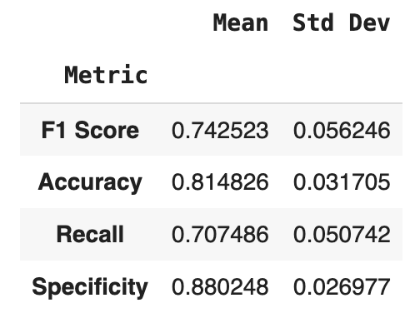
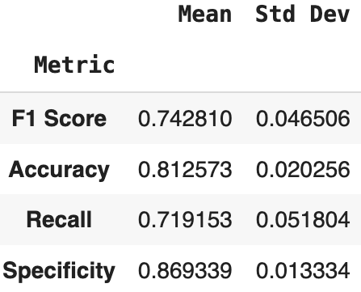
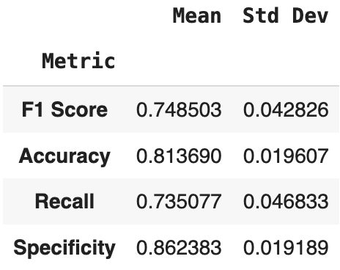
GENERAL METRICS
Support Vector Machine
Random Forest
Logistic Regression

Slide 28
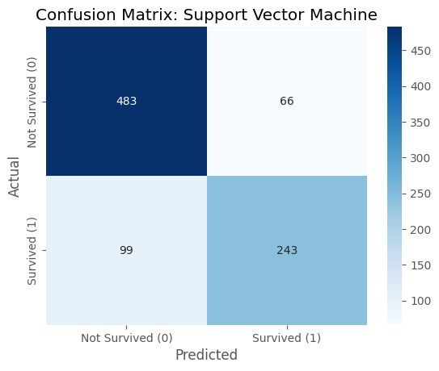
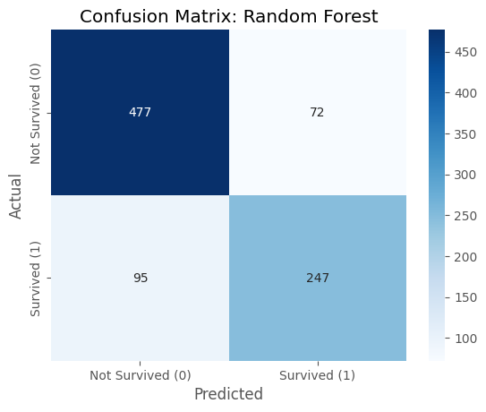
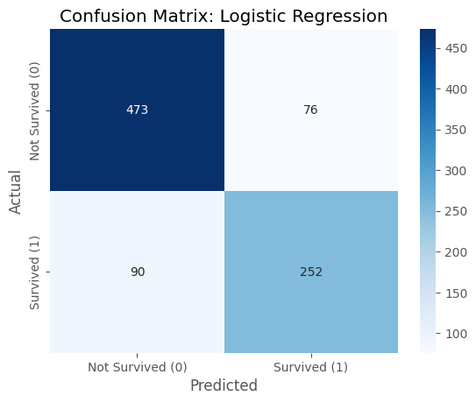
CONFUSION MATRICES

Slide 29
BEST MODEL
1

Slide 30
LOGISTIC REGRESSION
Pros:
Good mean F1 score (0.75)
Good mean accuracy (0.81)
Lower standard deviation for most metrics
Higher mean recall
Higher mean negative predictive value
Lower mean miss rate
Easy interpretation
Fast training
Cons:
Lower precision
Higher fallout
Lower specificity
Results:
Kaggle Score: 0.7751
ROC AUC = 0.87

Slide 31

PYSPARK COMPARISON
PySpark Training time: 3.85 seconds
SciKit Learn Training time: 0.03 seconds
Too small dataset

Slide 32
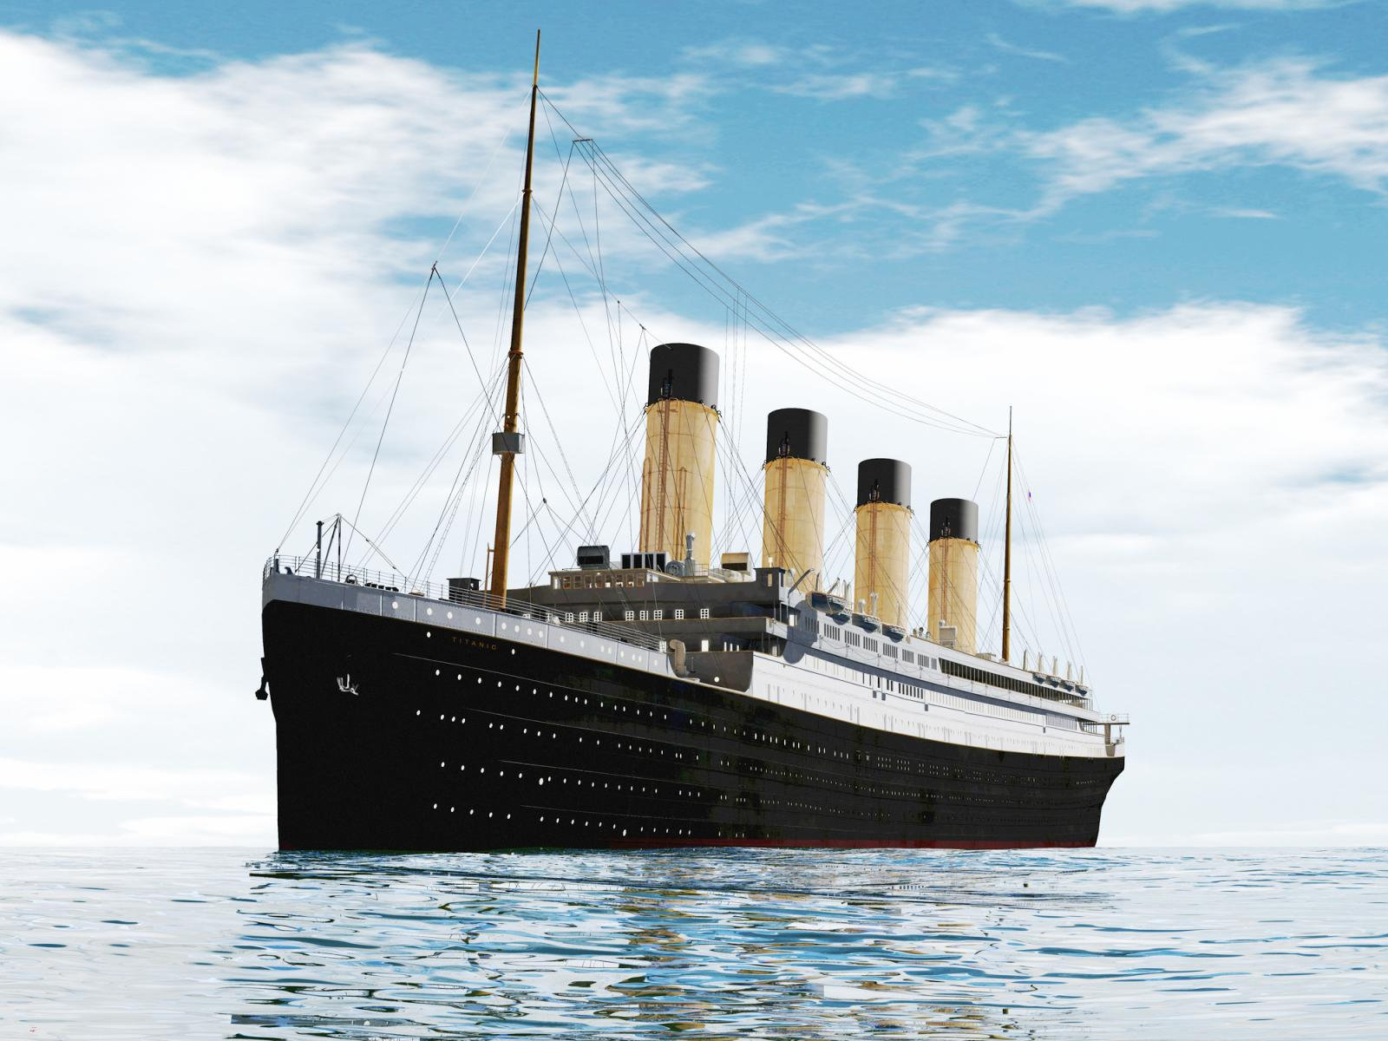
CONCLUSION
General objective:
Predict Titanic survival of Kaggle dataset
Recall ≥ 0.7
Specificity ≥ 0.85
How to do it?:
Analyse the data
Fill the missing data
Select useful features
Select correct algorithms
Train the models
Evaluate the model
Results:
Transformed dataset
Logistic regression model
Mean F1 score: 0.74
Mean Specificity: 0.86
Mean Recall: 0.73
Kaggle Score: 0.7751
How to improve?
More exhaustive analysis
Better feature engineering
Better hyperparameter tuning

Slide 33
Q&A
1

Slide 34

THANK YOU
JESÚS ALEXANDER MEISTER CAREAGA A01656699
IKER S. BALI ELIZALDE A01656437
MICHELLE AGUIRRE MARTÍNEZ A01661592
DIEGO SÁNCHEZ HERNÁNDEZ
A01783237

Slide 35
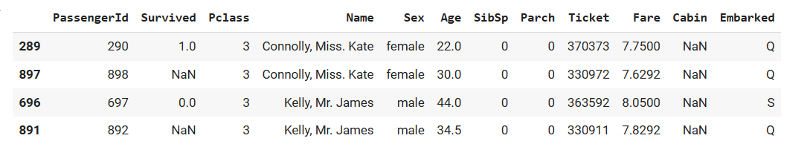
DUPLICATE DATA

Slide 36
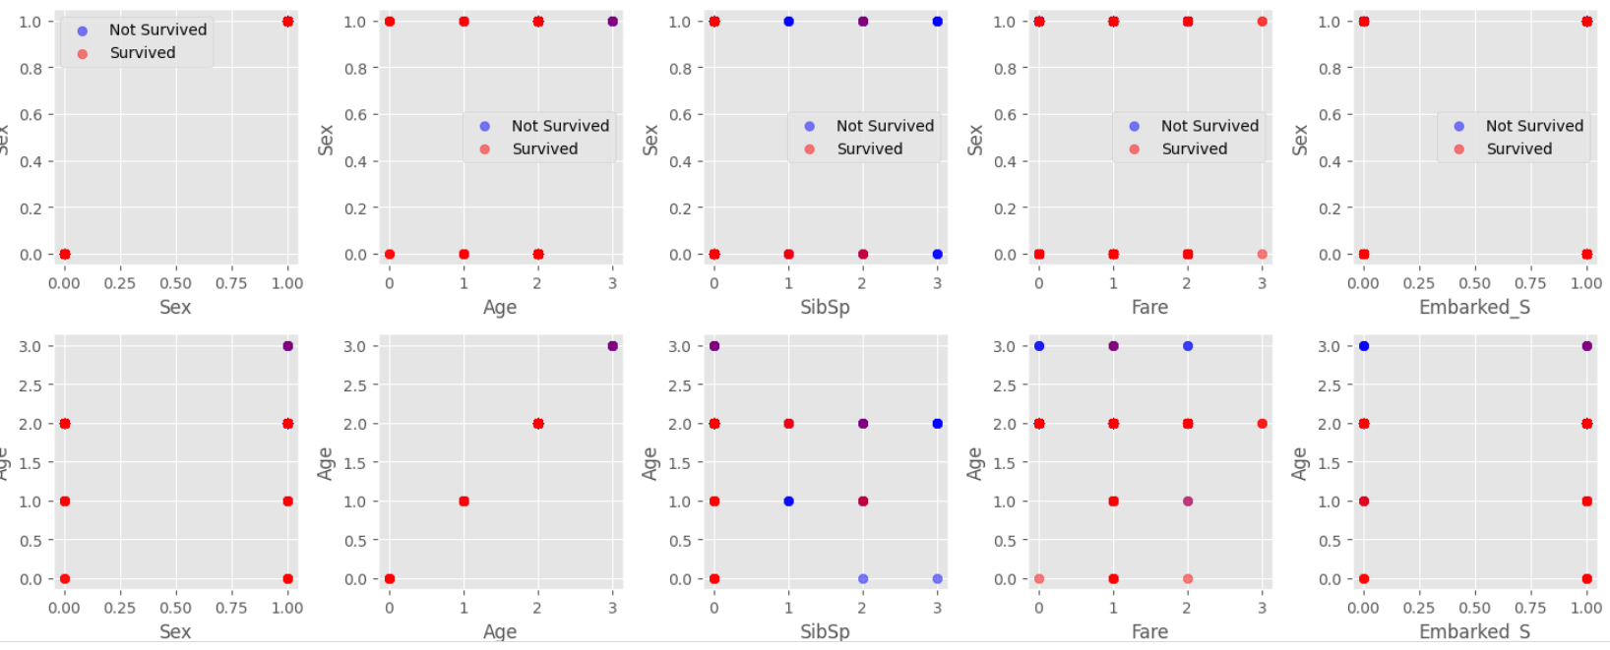
FINAL ANALYSIS

Slide 37
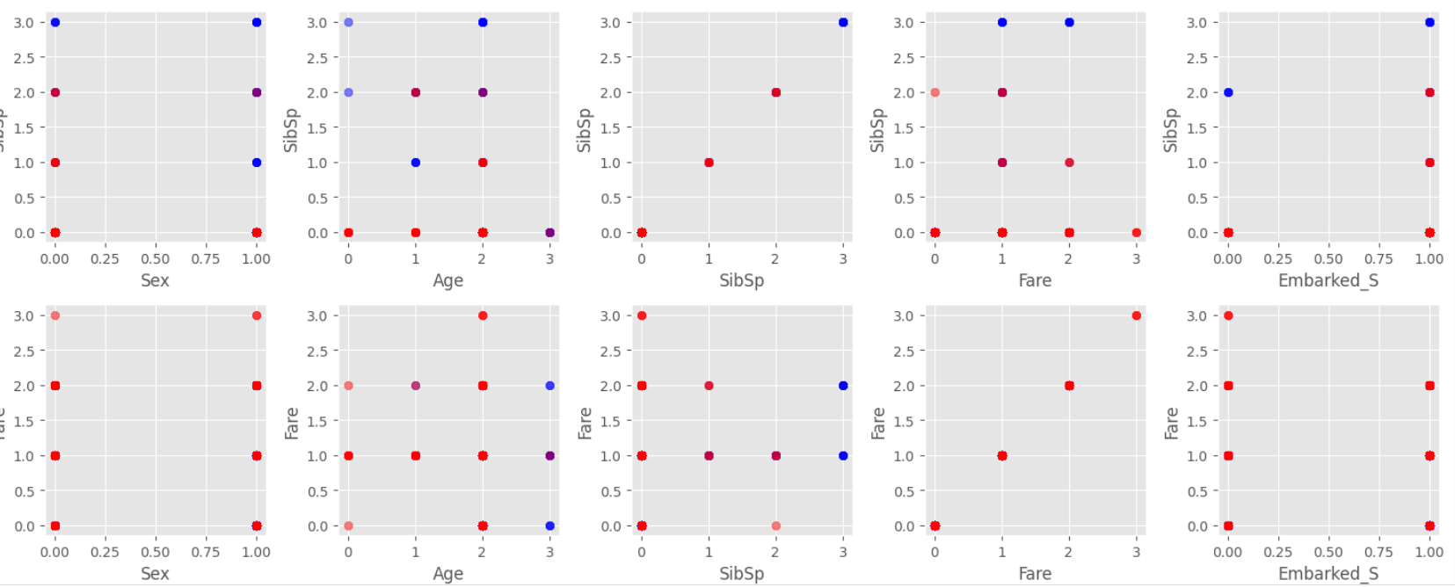
FINAL ANALYSIS

Slide 38
FINAL ANALYSIS

Slide 39
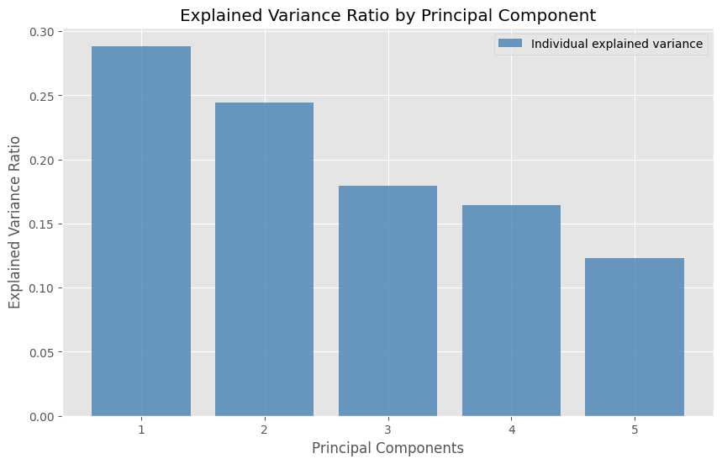
FINAL ANALYSIS

Slide 40
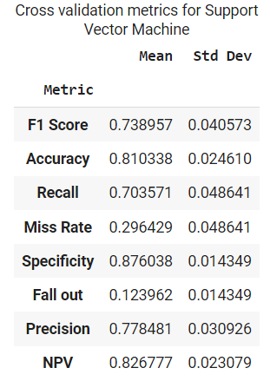
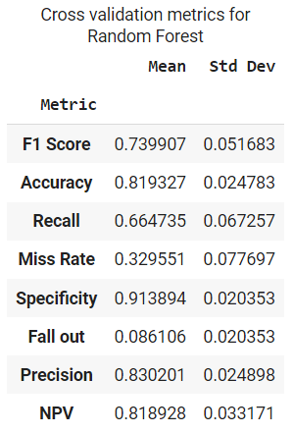
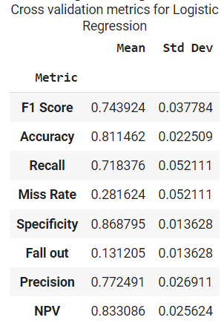
TRAINING WHILE LEAVING EMBARKED VARIABLES

Slide 41
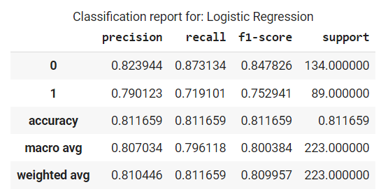


CLASSIFICATION REPORTS

Slide 42


ALTERNATIVE MODEL TESTING

Slide 43



F1 VALUES

Slide 44


LOGISTIC REGRESSION

Slide 45

LOGISTIC REGRESSION

Slide 46



Precision Recall Curves

Slide 47

YOUDEN INDEX
Youden Index: specificity + recall - 1

